Slide 1
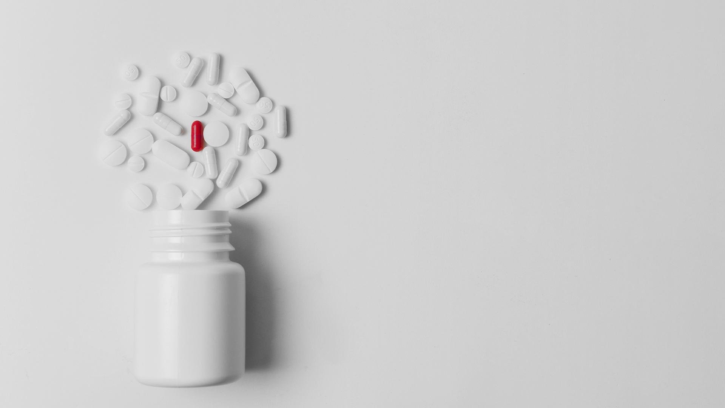
WHEN ARE
MY DRUGS?
Calvin Chen, Conan Truong, Jessie Chang, & Kelly Lue

Slide 2
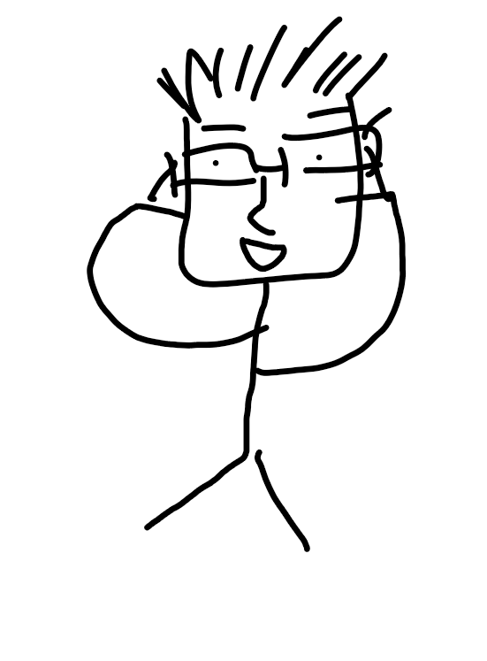
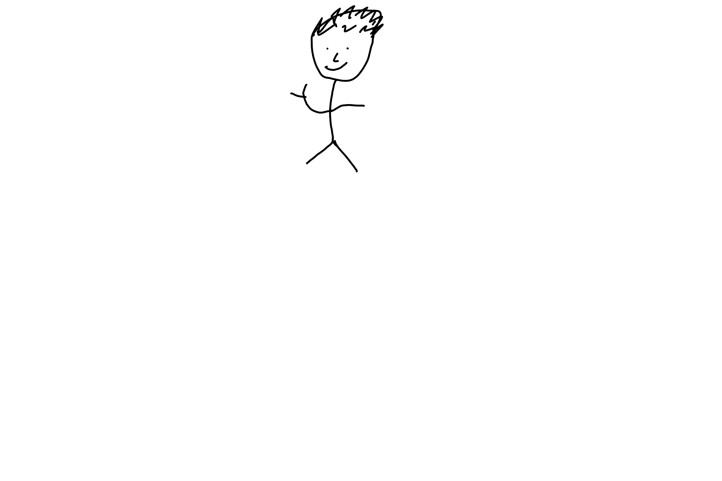
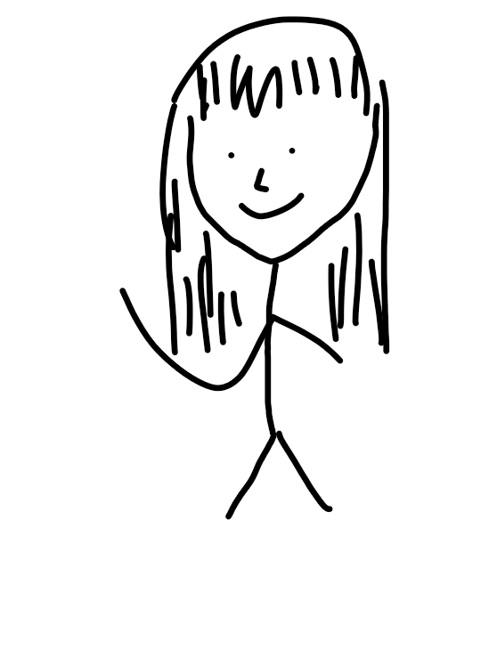
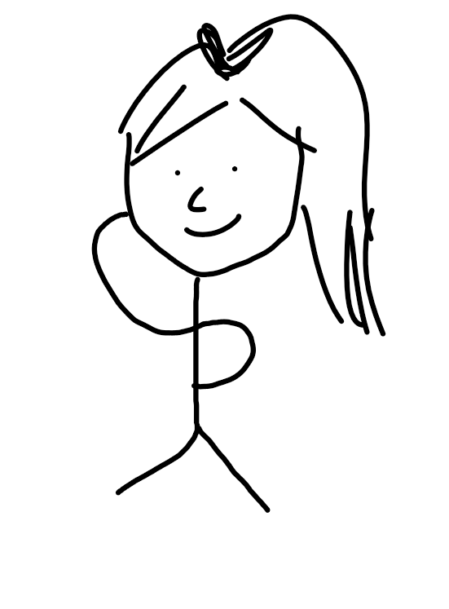
MEET THE TEAM
01
02
03
04
CALVIN CHEN
CONAN TRUONG
JESSIE CHANG
KELLY LUE
Computer Science, UC San Diego 2022
Computer Science, UC Irvine 2022
Business Information Management, UC Irvine 2022
Electrical Engineering, UC Irvine 2022

Slide 3
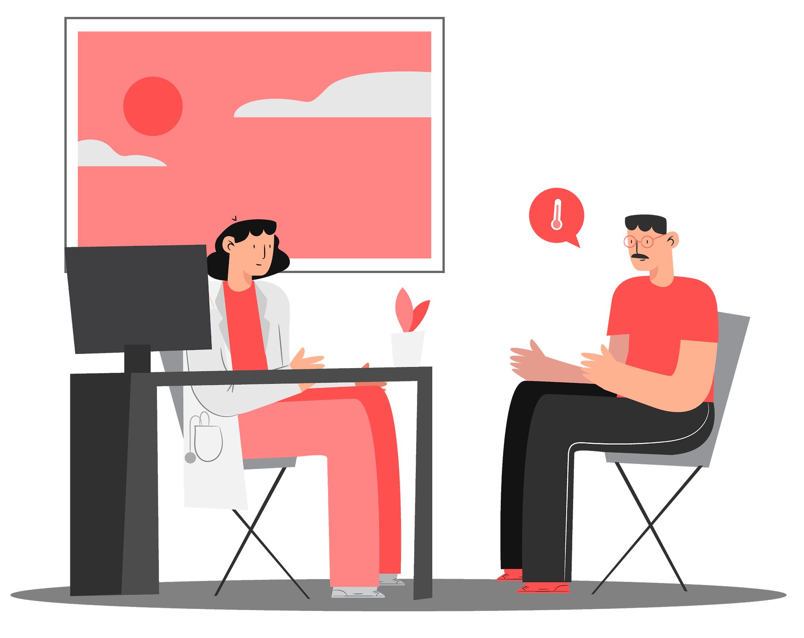
How many times have you forgotten to take prescription medication?
When Are My Drugs? is a Java application that puts forgetting in the past.

Slide 4
OUR RESOLUTION
CHOOSE TIME TO TAKE MEDICINE
USER-INPUTTED DRUGS
OPTIONS TO REPEAT ALARMS
SYNC TO MEDICINE BOX*
CUSTOMIZE TIME INTERVALS
CHOOSE DAYS TO TAKE MEDICINE
Choose a time for when to take each medicine.
12
App allows users to input their own prescription.
Choose frequency of alarms during day.
9
WHEN ARE MY DRUGS?
3
(hopefully) be able to link to weekly medicine container.
Be reminded whenever you feel is necessary!
6
Options to choose what day of the week medicine is needed.

Slide 5
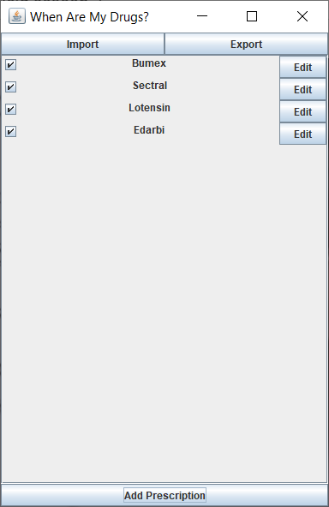
SCREENSHOTS OF GUI

Slide 6
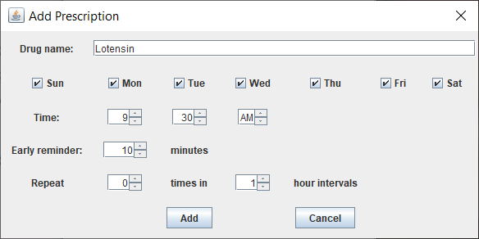
SCREENSHOTS OF GUI

Slide 7
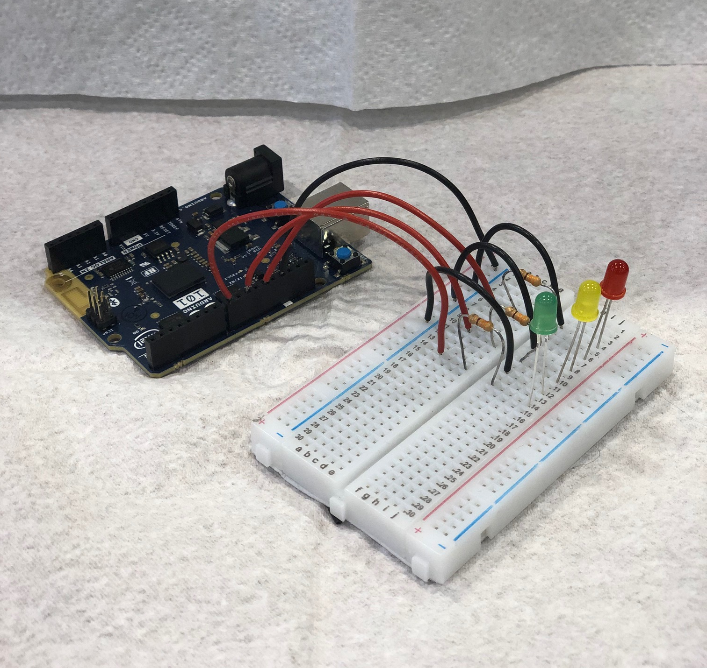
MEDICINE BOX LIGHT PROTOTYPE
Arduino 101
red, yellow, & green LEDs
Simple Arduino program flashes each light 5 times to remind user at specified time interval.
Green: first reminder
Yellow: second reminder
Red: final reminder

Slide 8
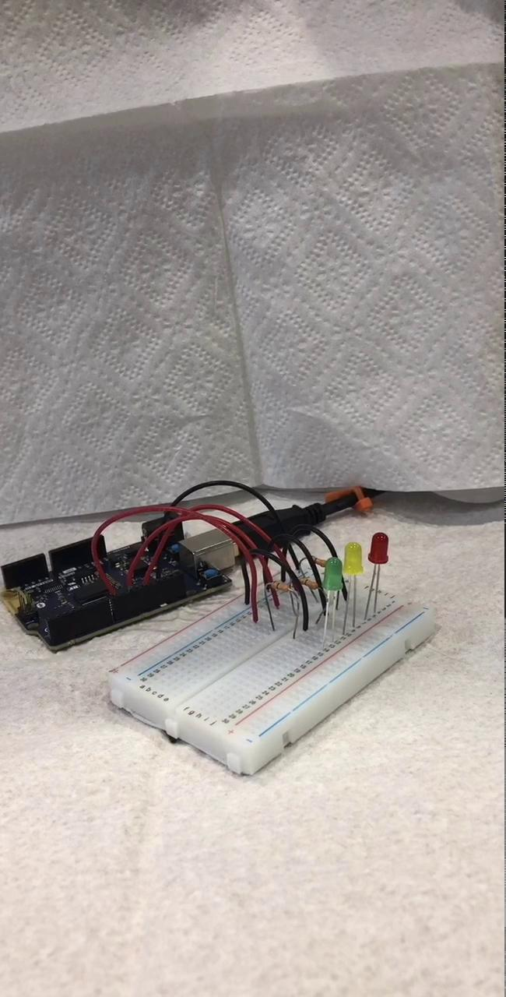
MEDICINE BOX LIGHT DEMONSTRATION
*this video was sped up so you didn’t have to sit here watching LEDs flash in hour intervals.

Slide 9
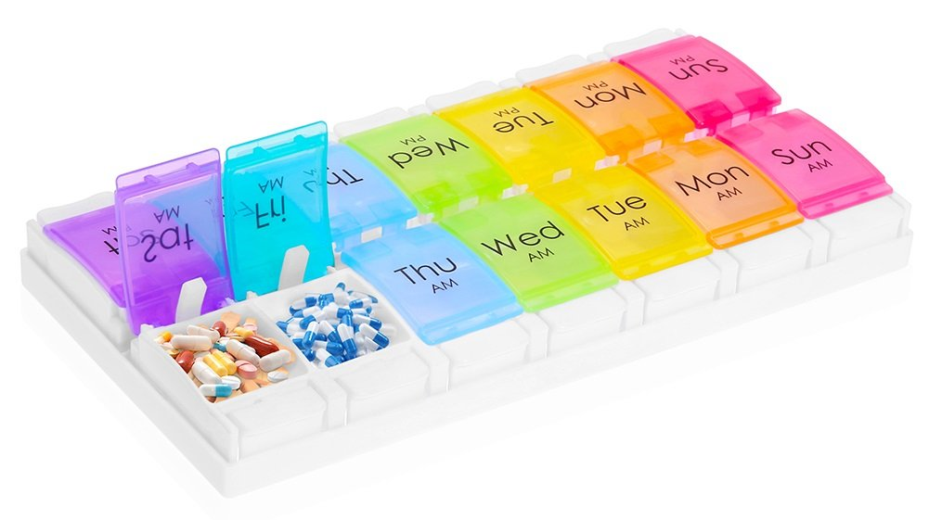
FUTURE GOALS & IMPROVEMENTS
01
02
03
MOBILE APP
INTEGRATING HARDWARE ON MEDICINE BOX
ACCESS PATIENT DATA
For the convenience of portability.
Instead of manually inputting prescriptions, import from patient databases.
So the LED’s flash on each containment’s lid to remind users on their designated days to take medicine.

Slide 10
THANKS!
Does anyone have any questions?

